Slide 1

Welcome to Back to School Night
September 23th 2021-22
cflanagan@jacksonsd.org

Slide 2
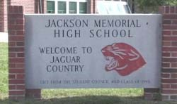
Mrs. Christine Flanagan
cflanagan@jacksonsd.org
SMART English (Period 1)
English II ICS(Period 3)
English II ICS (Period 4)
ENGLISH DEPT GRADING
_____________________________________
Please review the on line student handbook for school expectations, dress code and personal device policy.

Slide 3

Transition English Pr1 cflanagan@jacksonsd.org
Text:
Technology: FLEX
Novels: Adapted novels,
Fiction and Non Fiction, short stories
Poetry : various sources
Assessments: teacher made, Project based, observation based

Slide 4
English II cflanagan@jacksonsd.org
Text: Collections Grade 10
Close Reader Grade 10
Technology: Chromebook
Covered Content:
Novels
Short Stories
Poetry
Assessments: teacher made, Project based
Final Exam: Authentic Assessment

